Slide 1
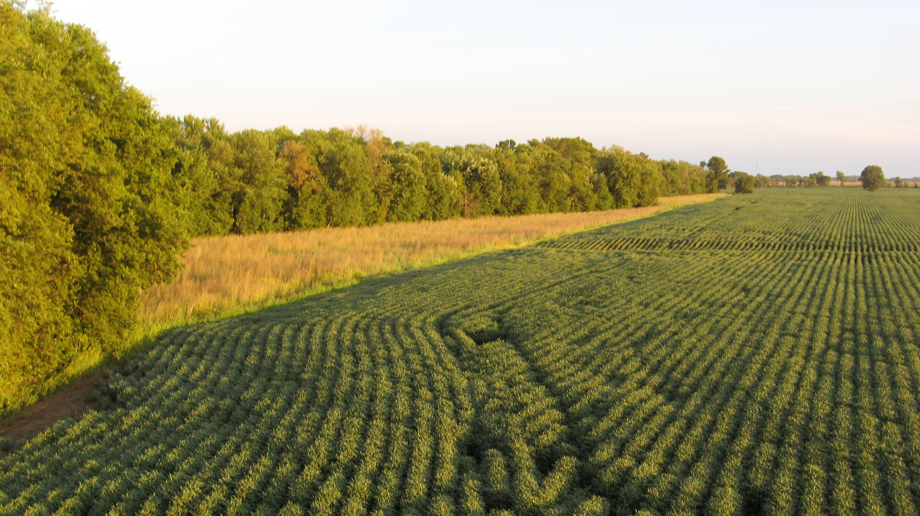
Buffer Zones
Photo courtesy of the Iowa Agriculture Water Alliance and the Iowa Soybean Association
Filtering out excess nutrients.

Slide 2
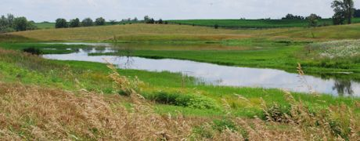
Types of buffer zones
Saturated Buffer: allow nutrients to be removed by redistributing tile water into the riparian buffer soil profile before reaching the stream

Slide 3
Types of buffer zones
Saturated Buffer:
Water level control structure is installed near the outlet of a tile line, within or immediately adjacent to an existing stream buffer.
A portion of the water is diverted into a tile line parallel to the stream and within the buffer.
Excess nitrate in the tile flow is converted to harmless nitrogen gas in the soil of the stream buffer due to organic matter and low oxygen.
Advantages include:
low maintenance,
simple to install
reasonable cost.
Challenges include:
site specific soil investigations are required;
interim practice standard complicates within CRP areas;
very few people have experience with site assessment, design, and installation;
a buffer of perennial vegetation is needed.
must assure impacts of impeded drainage on the cropland upstream are minimal and that streambank soils will remain stable with prolonged saturation.

Slide 4
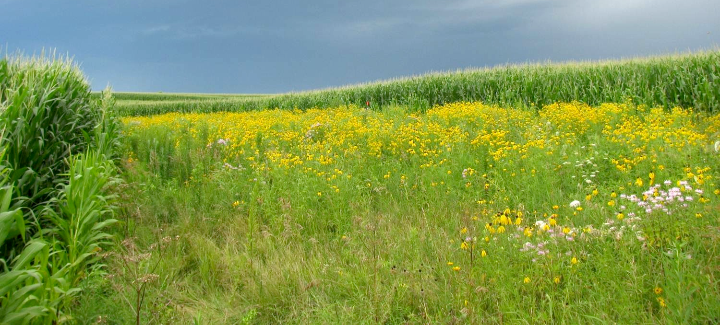
Types of buffer zones
Prairie Strips: Buffer strips of native prairie grasses placed on the contour in crop fields, combined with filter strips of prairie grass strategically placed where runoff leaves the field.
Photo courtesy of the Iowa Agriculture Water Alliance and the Iowa Soybean Association

Slide 5
Types of buffer zones
Prairie Strips: results in large improvements in runoff water quality with only a small (~10%) portion of the field taken out of row crop production.
Iowa State University data has shown that returning only a small fraction of cropland to deep rooted, native prairie plants with stiff, upright stems can dramatically reduce soil erosion by 95%,
Reduces losses of nitrogen by 85% and phosphorus by 90% in surface runoff.
Stiff-stemmed native grasses provide greater water quality benefits than non-native grasses like smooth bromegrass because the native grasses are much less likely to lay flat when there is runoff.
Small prairie areas can provide important habitat for pollinators and at-risk species.
No negative impacts on crop yield.
Can potentially be enrolled in programs such as CRP to receive rental payments and to help with the cost of the seed mixes.

Slide 6
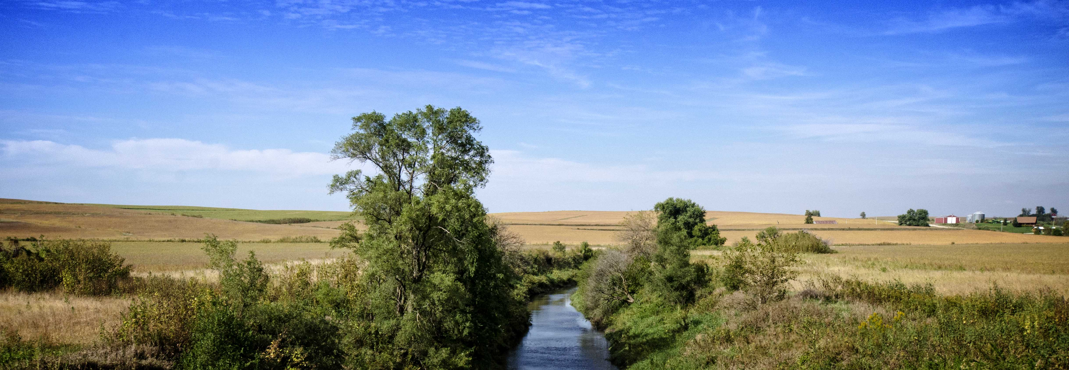
Types of buffer zones
Stream Buffers: Buffers are grassy or native vegetation adjacent to streams that trap sediment from surface runoff.
Photo courtesy of the Iowa Agriculture Water Alliance and the Iowa Soybean Association

Slide 7
Types of buffer zones
Stream buffers:
reduce phosphorus entering a waterway,
filter nitrogen as it moves in groundwater through the soil,
stabilize stream banks and provides habitat for wildlife.
AKA: riparian buffer strips and filter strips.
Areas surrounding water sources that have been taken out of agricultural production.
Planted with a variety of grasses, shrubs and/or trees that help improve water quality.
Primary benefit: trap soil and phosphorus in surface runoff before it reaches a stream or river.
Soil erosion must be well controlled on the land draining toward the stream buffer.
Uniform buffer is preferred by many producers for ease of installation
Varying the width of the stream buffer based on the amount of runoff that enters each section is more effective.

Slide 8
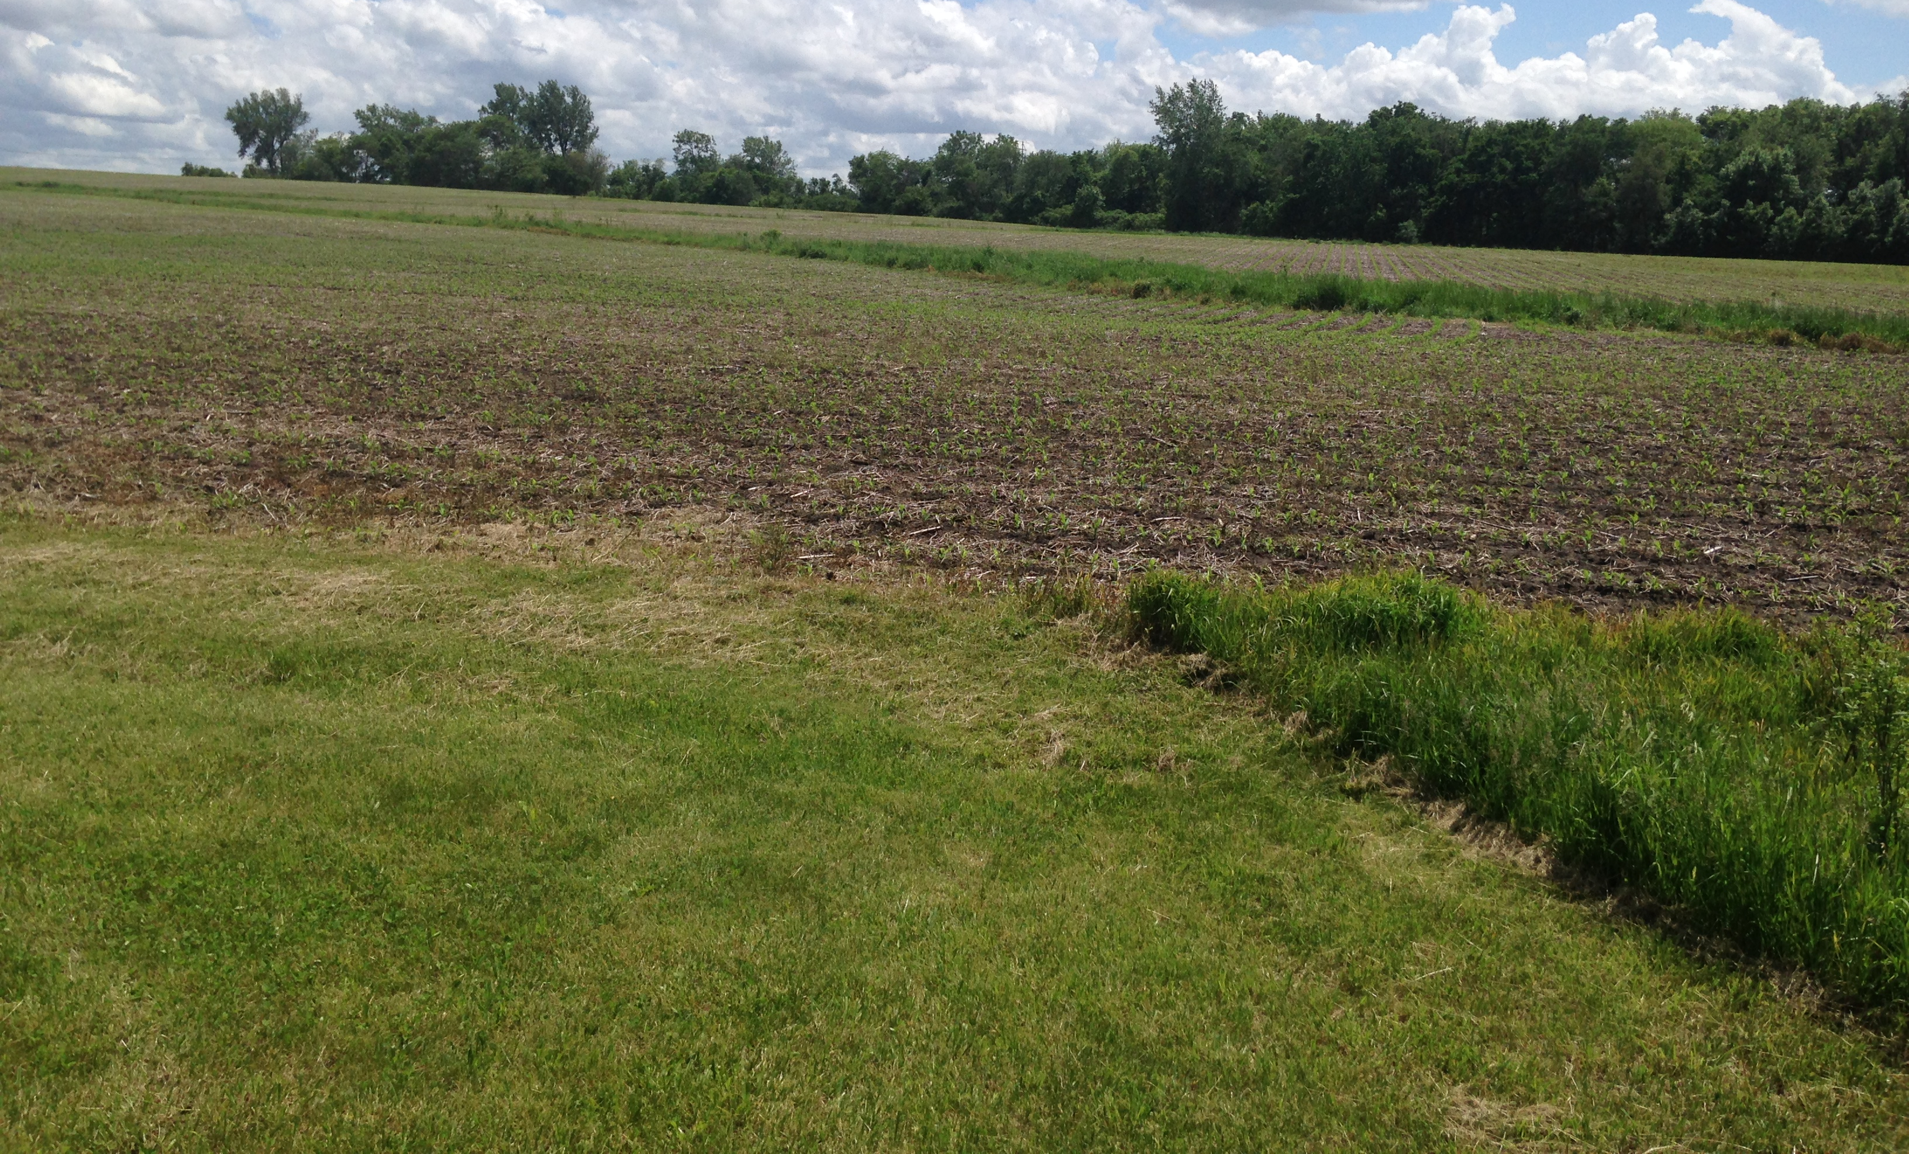
Types of buffer zones
Grassed Waterway: Areas within fields that are maintained in grass to address areas of concentrated water flow.
Photo courtesy of the Iowa Agriculture Water Alliance and the Iowa Soybean Association

Slide 9
Grassed waterway
https://youtu.be/S5qsgEgjsIk or https://youtu.be/y7HuoNy491w

